Slide 2
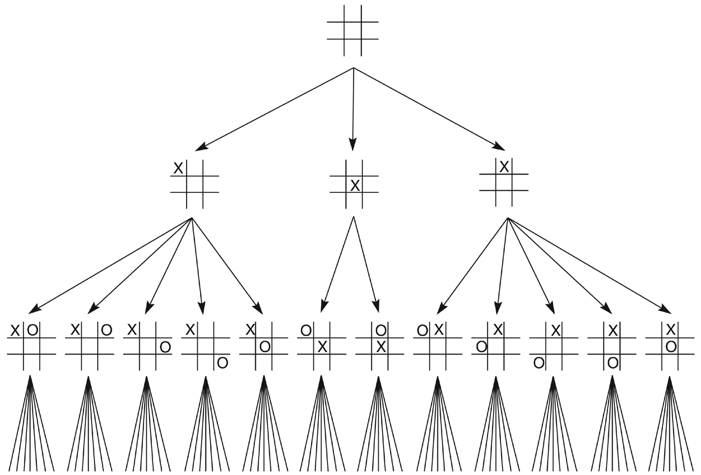
Figure 4.1: First three levels of the tic-tac-toe state space reduced by symmetry.

Slide 3
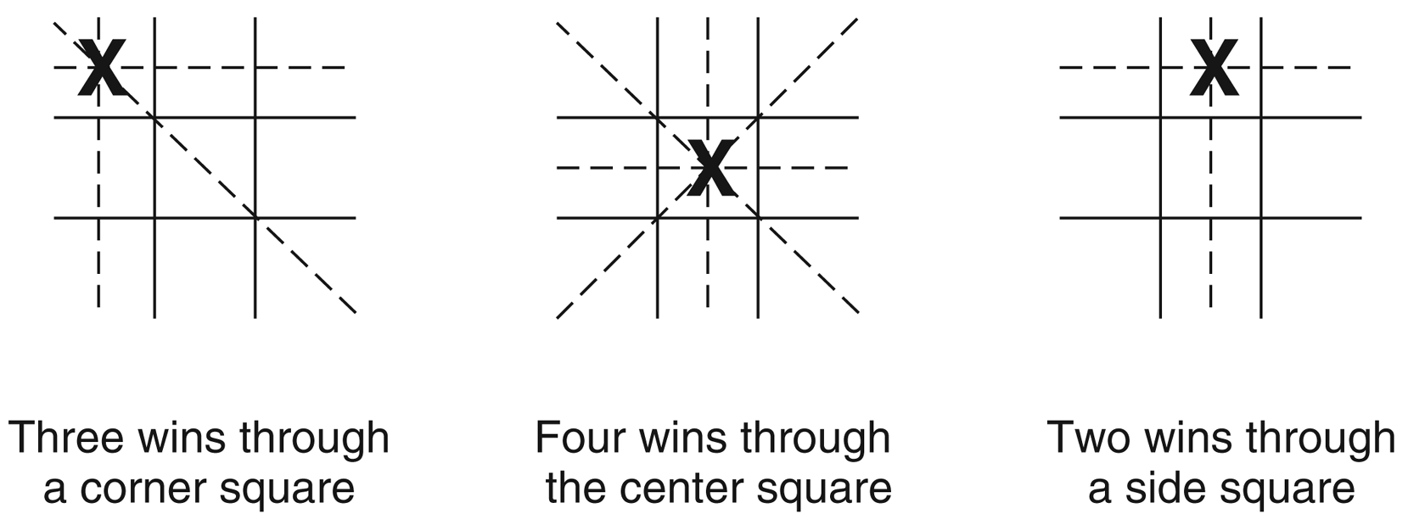
Figure 4.2: The “most wins” heuristic applied to the first children in tic-tac-toe.

Slide 4
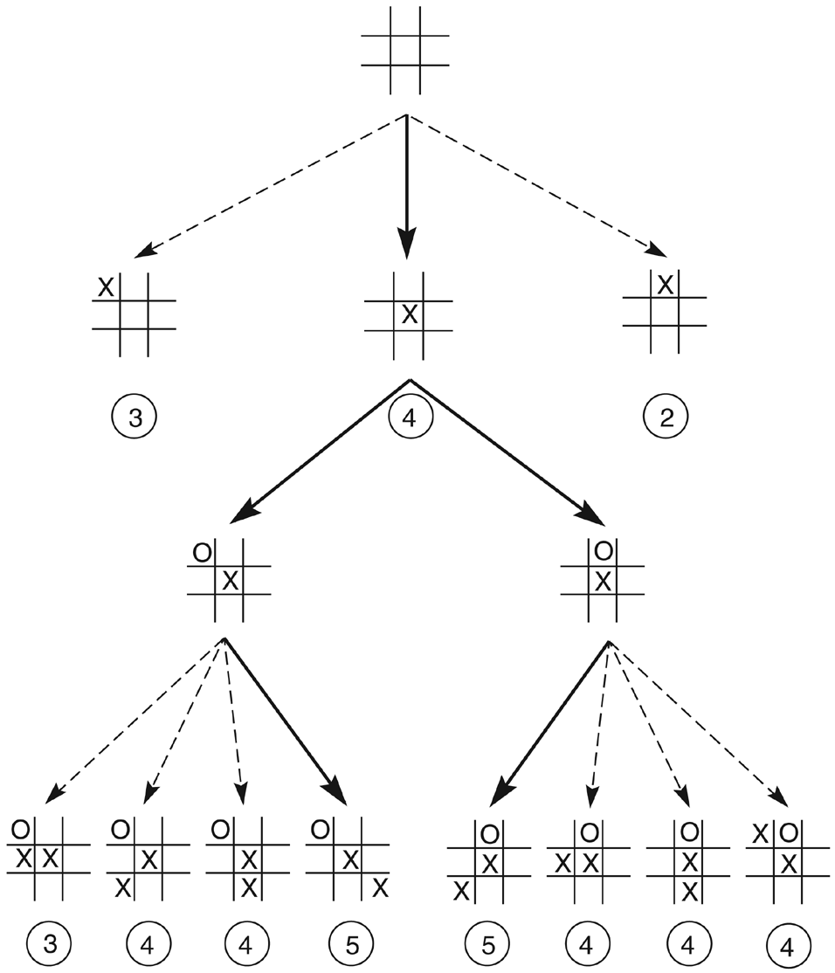
Figure 4.3: Heuristically reduced state space for tic-tac-toe.

Slide 5
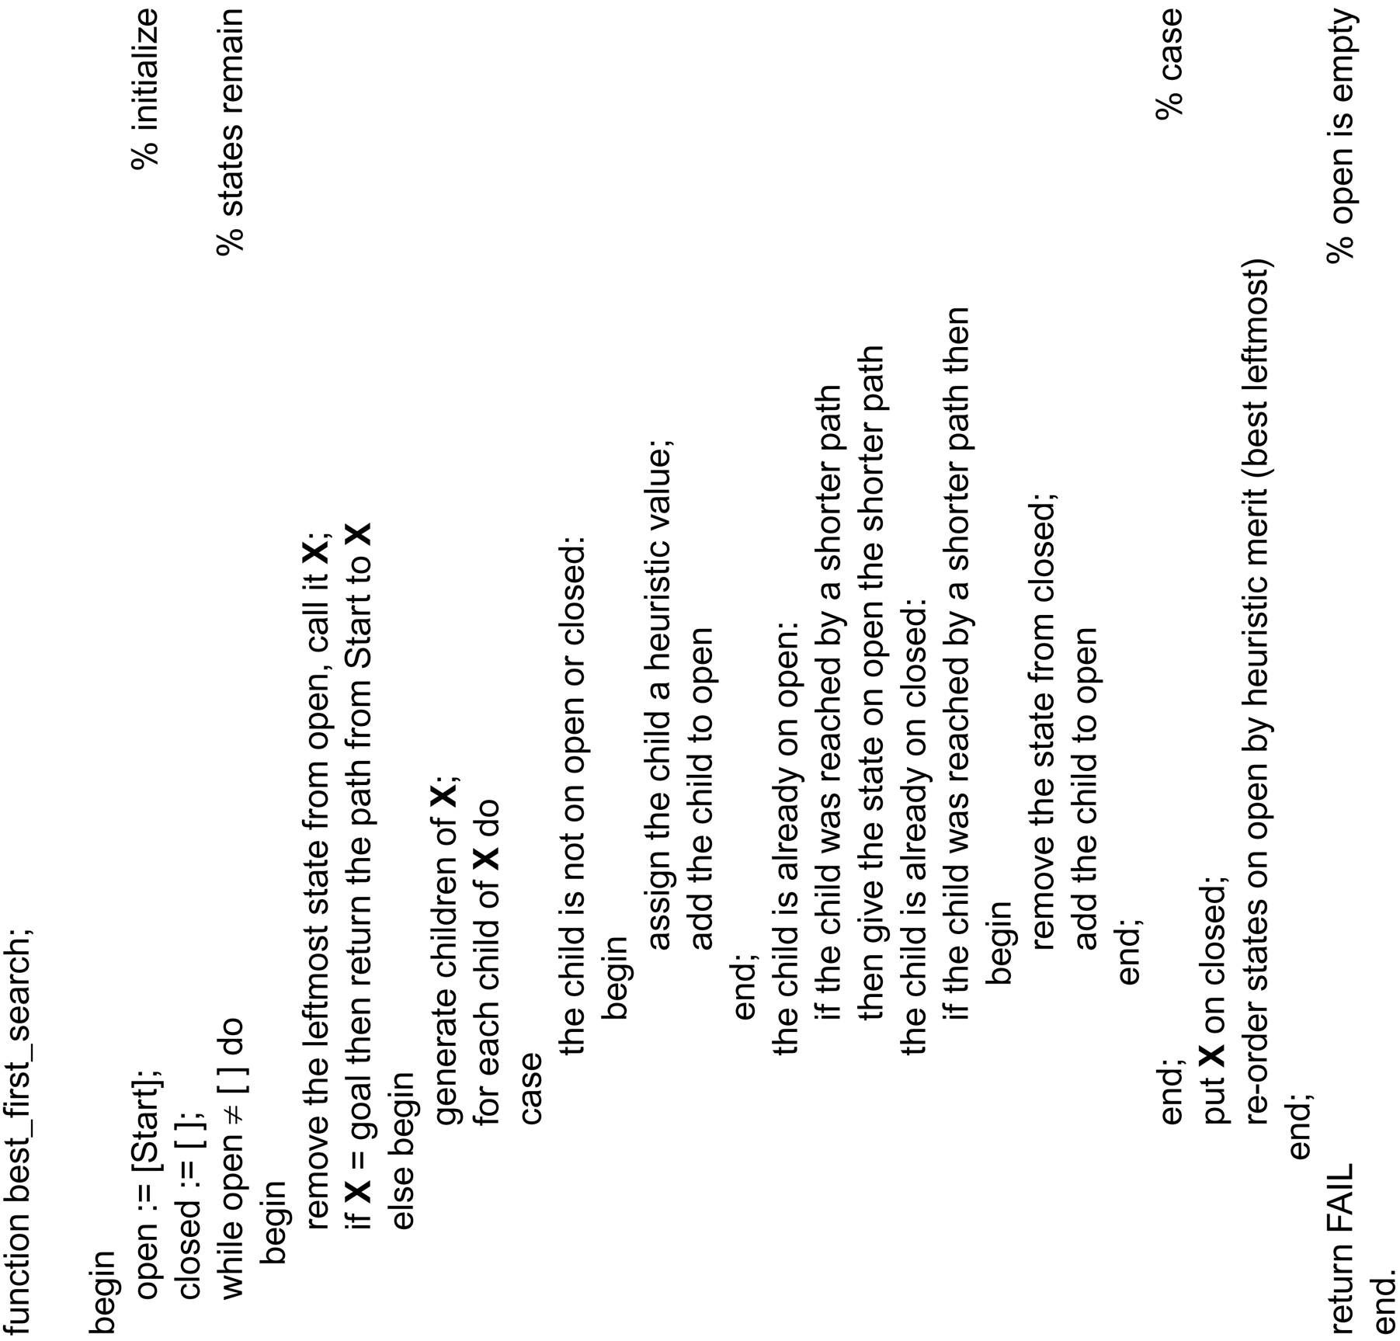
function best_first_search algorithm

Slide 6
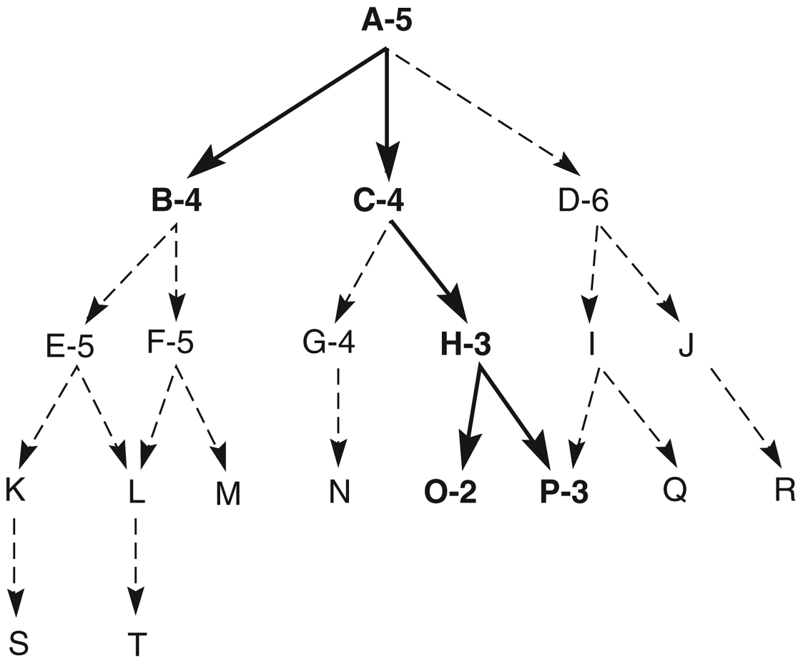
Figure 4.4: Heuristic search of a hypothetical state space.

Slide 7
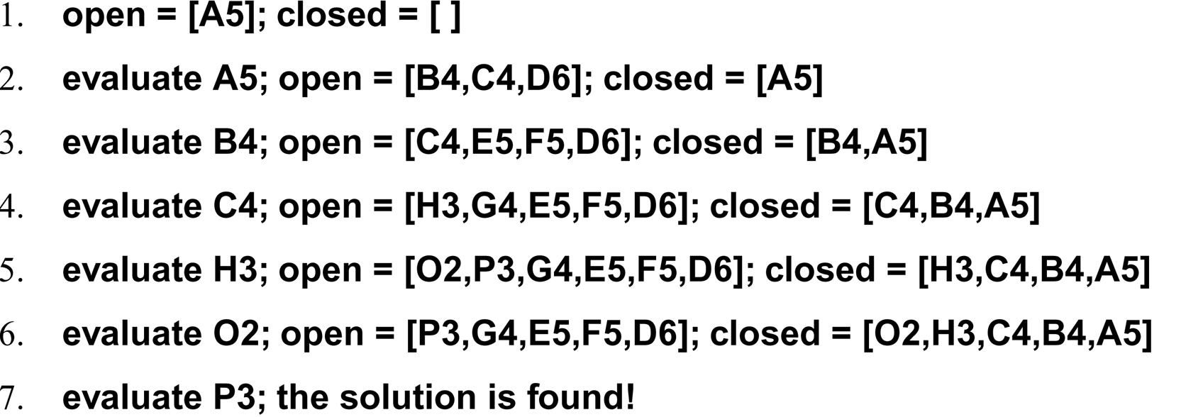
A trace of the execution of best_first_search for Figure 4.4

Slide 8
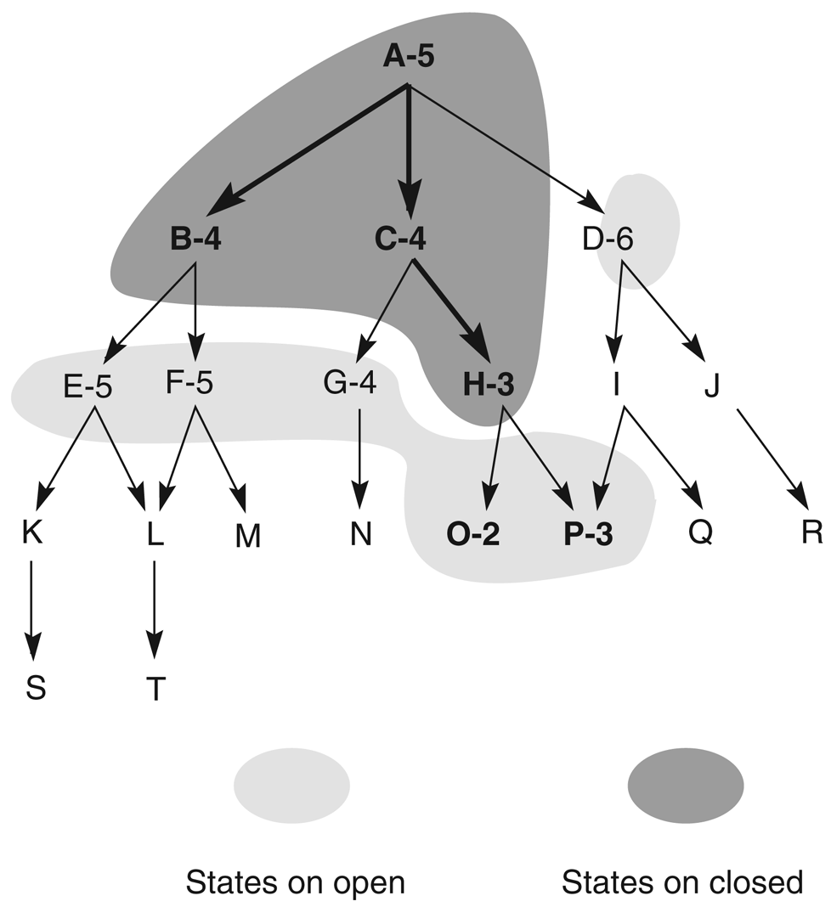
Figure 4.5: Heuristic search of a hypothetical state space with open and closed states highlighted.

Slide 9
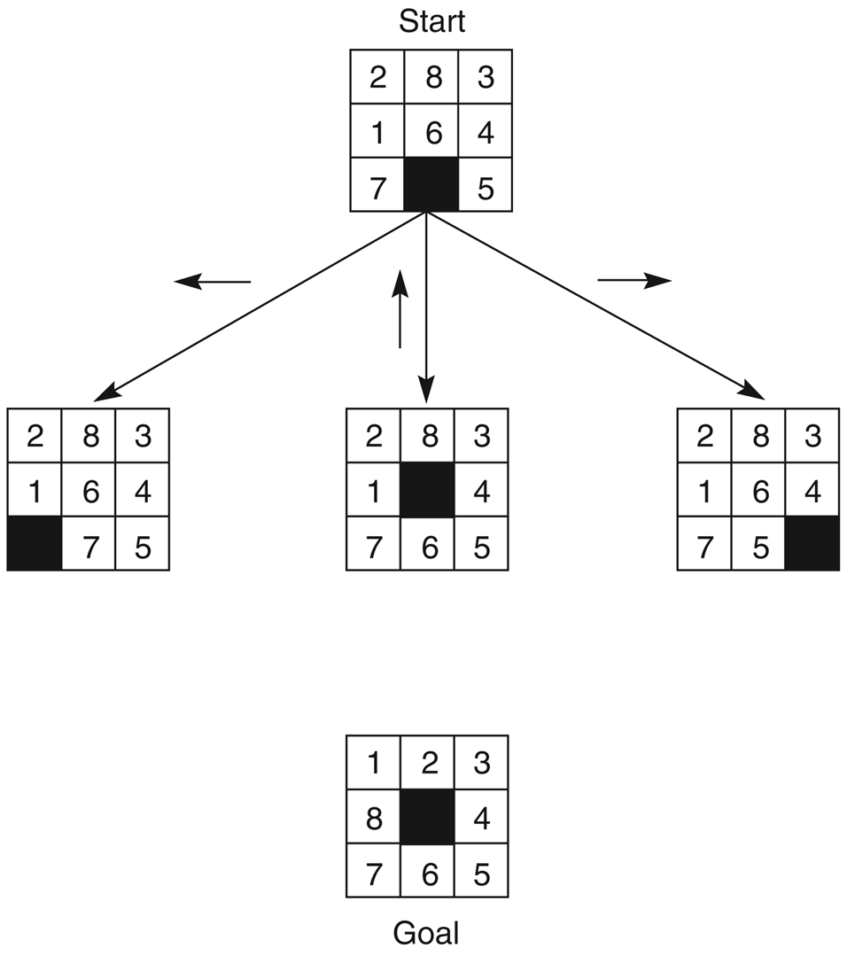
Figure 4.6: The start state, first set of moves, and goal state for an 8-puzzle instance.

Slide 10
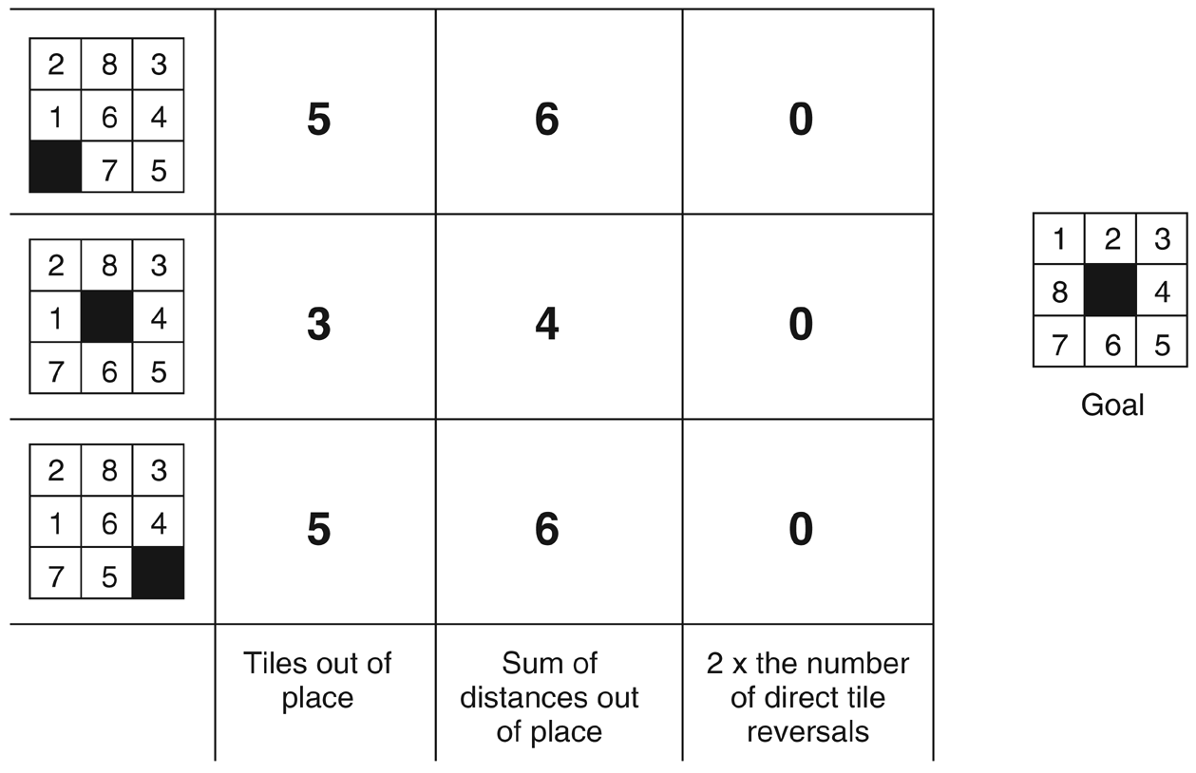
Figure 4.8: Three heuristics applied to states in the 8-puzzle.

Slide 11
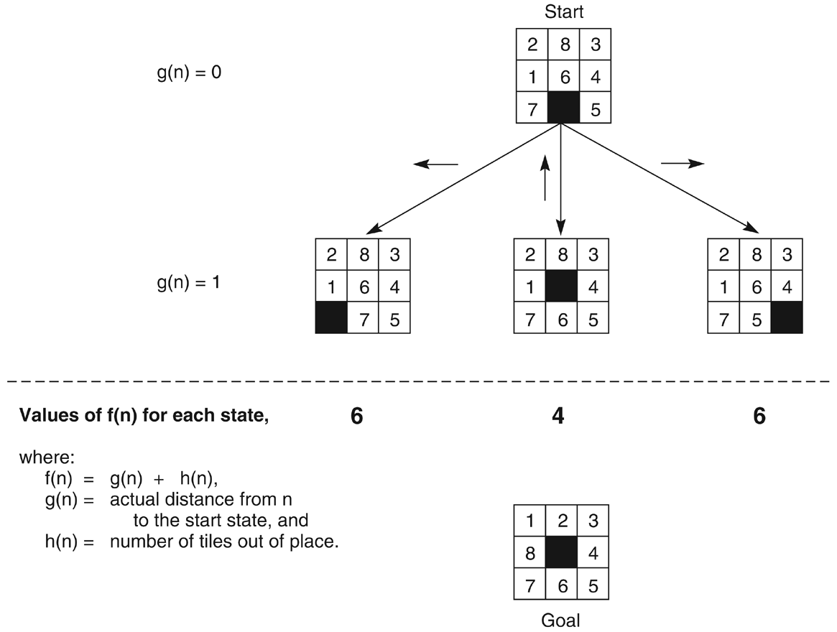
Figure 4.9: The heuristic f applied to states in the 8-puzzle.

